Slide 1


Front End Engineering Project
Faculty Coordinator: Dr. Amandeep Kaur
Presentation by:
Arnav Agarwal
Arpita ohlan
arjit

Slide 2


Table of Contents
o1.
Introduction
o2.
Problem Statement
o3.
Technical Details
o4.
Key Features
o5.
Project Highlights
o6.
Conclusion
o8.
References/Links Used

Slide 3

Introduction
Project Overview
This web application is central information hub for the kitchen.
This can give people the ingredients for their recipe.
The website gives them a variety of dishes to satisfy their cravings.
The visitors will be able to register to the website to get daily updates on the site development, offers and any additions in the recipes.
Users will be given an option to download the recipes.

Slide 4

Problem Statement
Today there are innumerable applications that provide consumers with recipes ranging from quick to healthy and from beginner to expert; all intending to save time.
But, none of these applications take into account whether he recipes ingredients are available with the consumer at the point of time or not. They fail to provide recipes containing only the ingredients that are available, thus, proving to be inefficient and wasting time rather than saving it.
These contemporary applications also do not evaluate and learn from the user's choices thus further increasing the user's task of repeating already fed information again.
We plan on using a content-based recommendation system that will learn from user's inputs and provide the user with refined recommended recipes which suit the user's needs.

Slide 5



Technical Details
HTML
CSS
NodeJS
The Hypertext Markup Language or HTML is the standard markup language for documents designed to be displayed in a web browser. It defines the meaning and structure of web content.
JavaScript often abbreviated as JS, is a programming language that is one of the core technologies of the World Wide Web, alongside HTML and CSS.
CSS, or Cascading Style Sheets, offers a flexible way to style web content.

Slide 6

Key Features
In this website user can easily access all their desired recipes.
All the ingredients are mentioned in a systematic manner along with the required quantities.
This site includes both veg as well as non veg items for all type of eaters.
Also keeping in today's diet world we have many salads and other healthy recipes.

Slide 7
Project Highlights

Slide 8
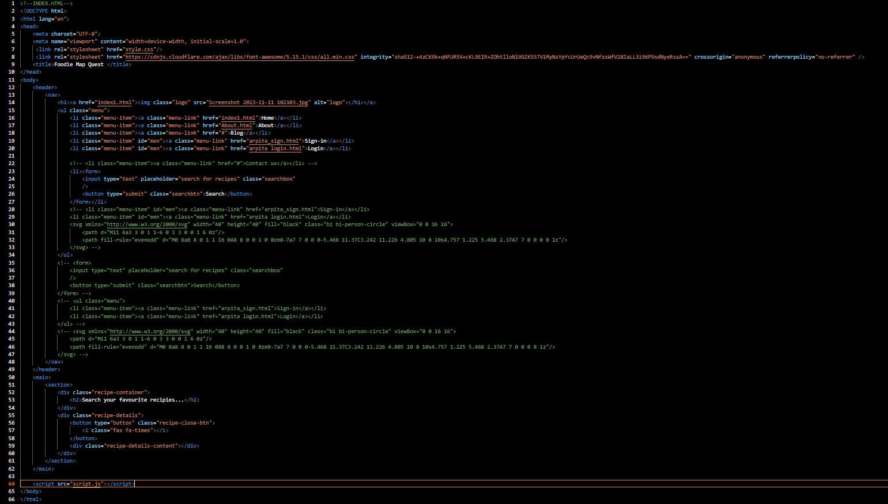
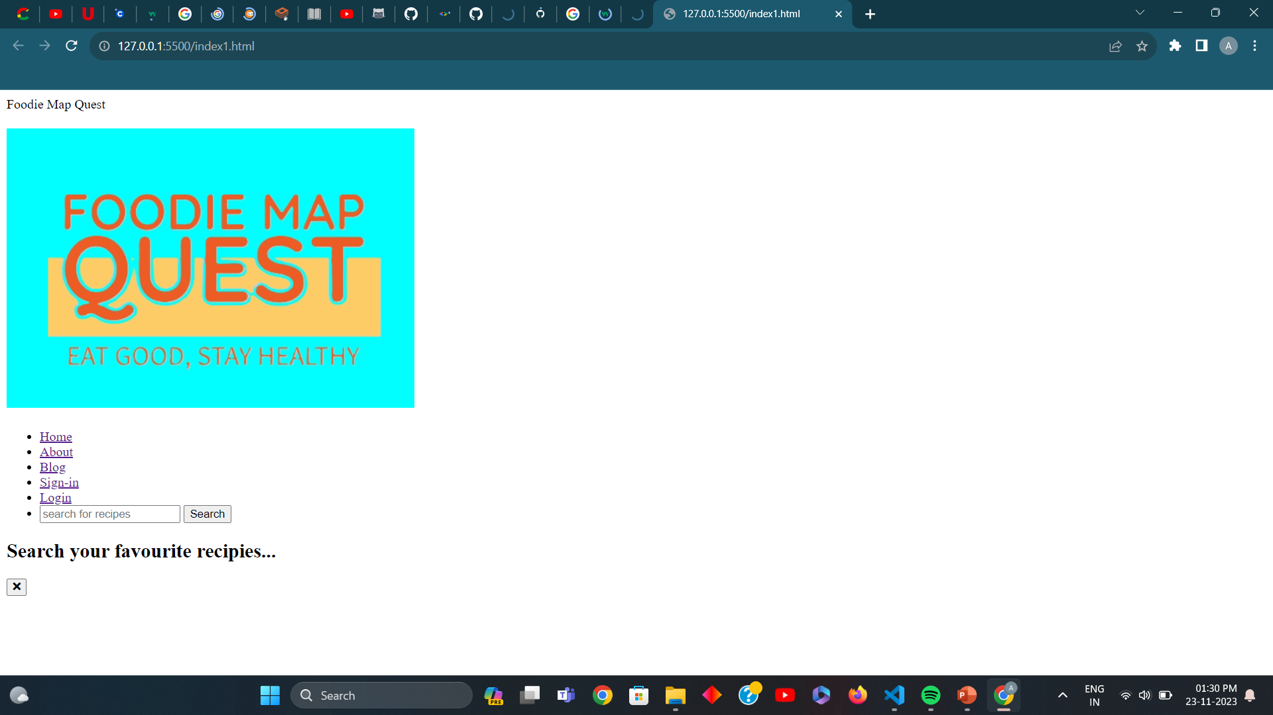
HTML

Slide 9
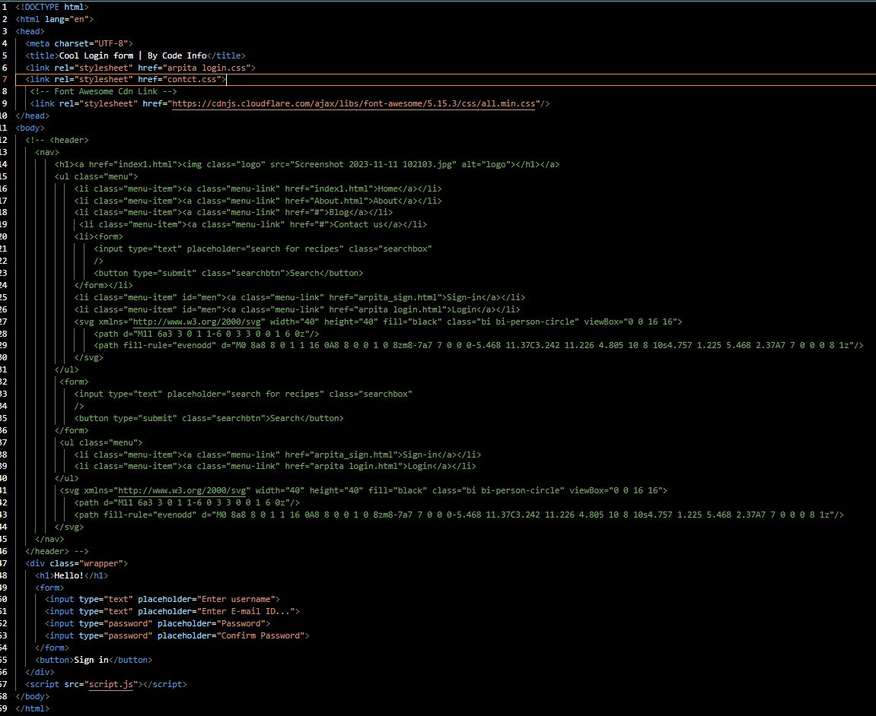
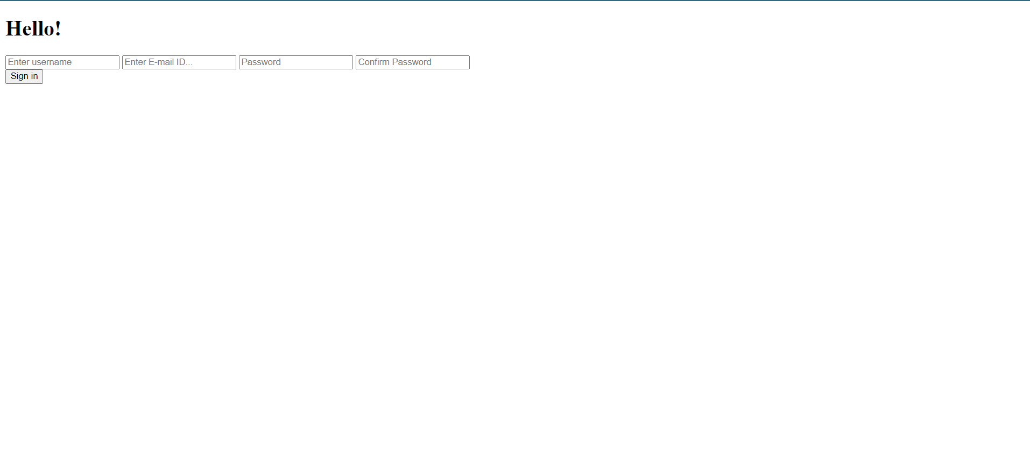
HTML

Slide 10
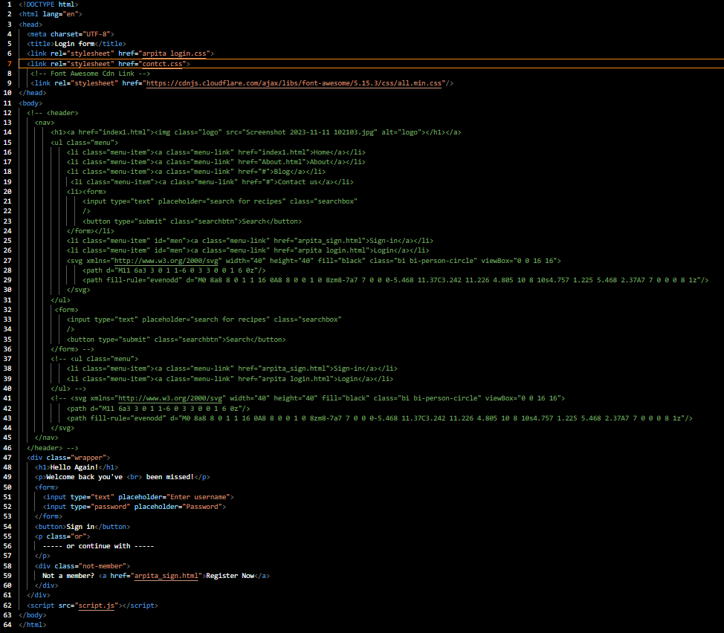

HTML

Slide 11
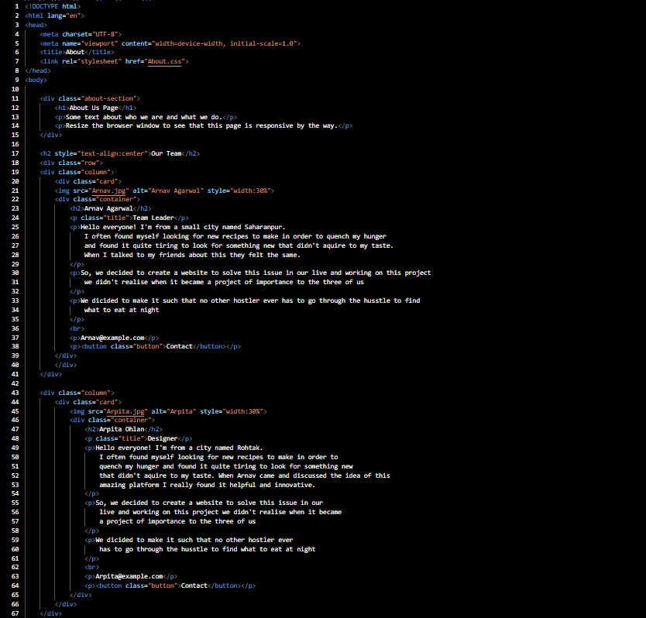
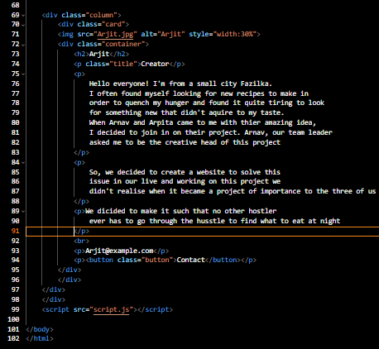
HTML

Slide 12
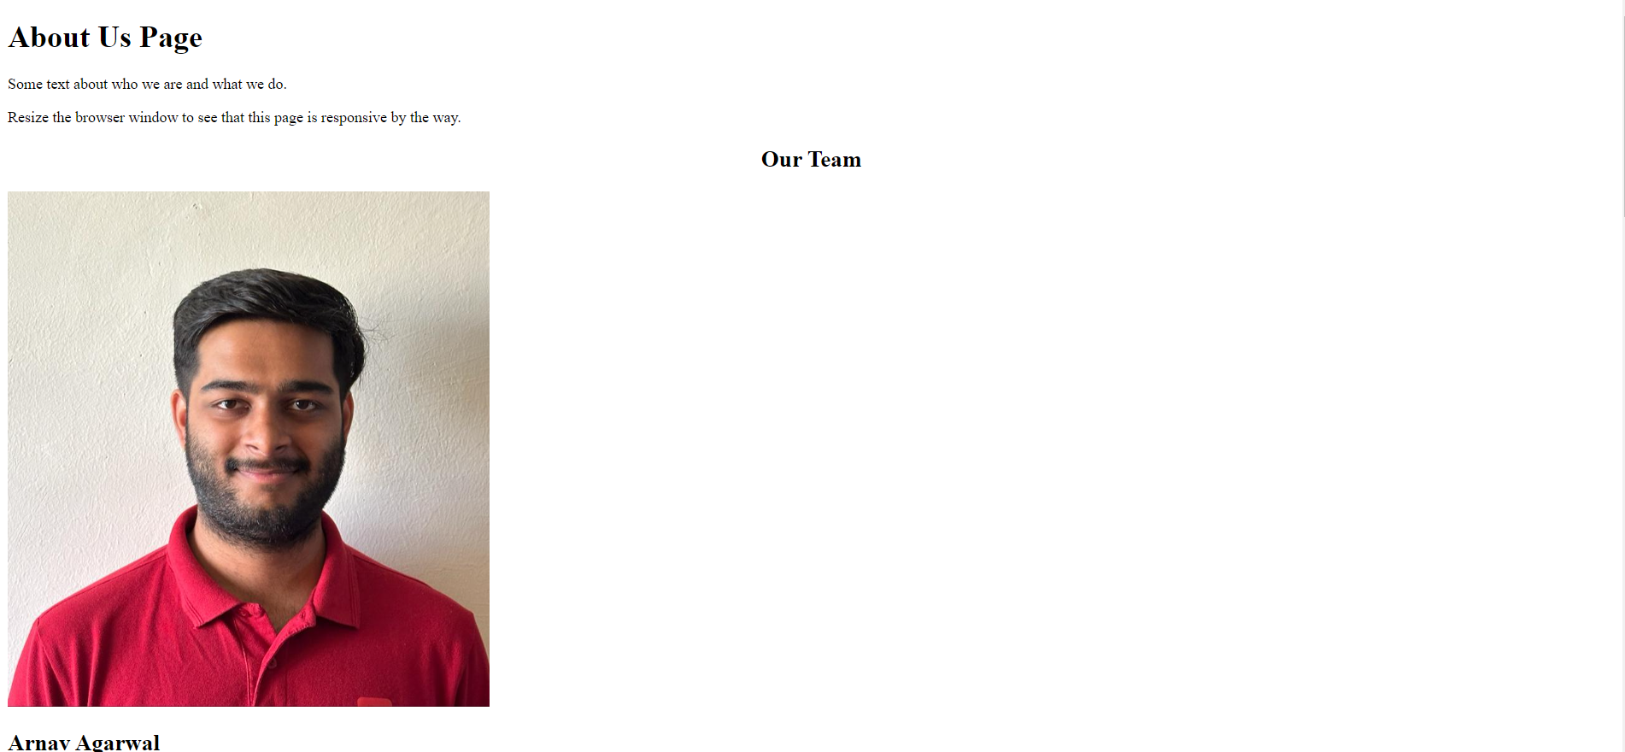
HTML

Slide 13
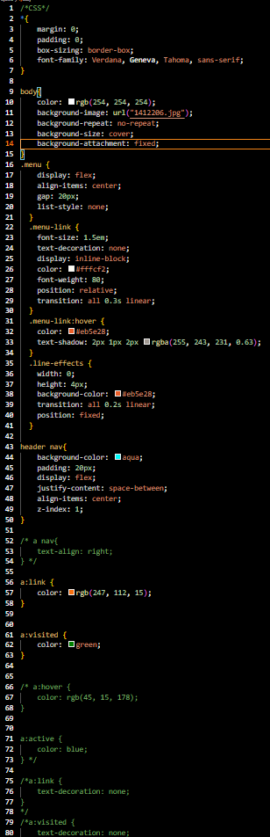
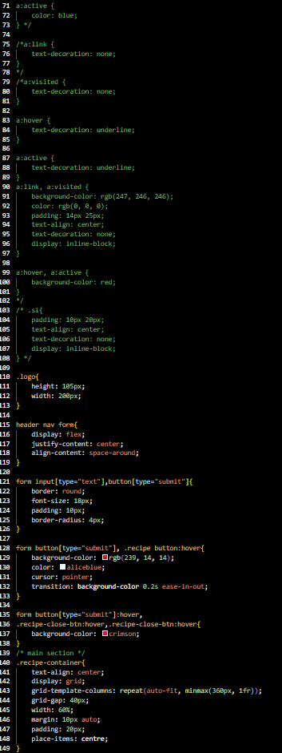
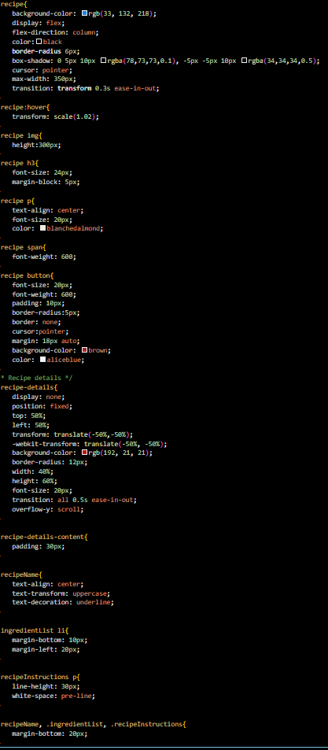
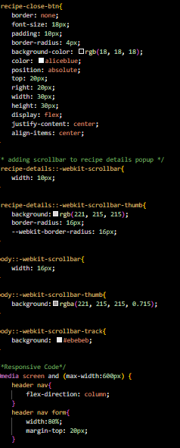
CSS

Slide 14
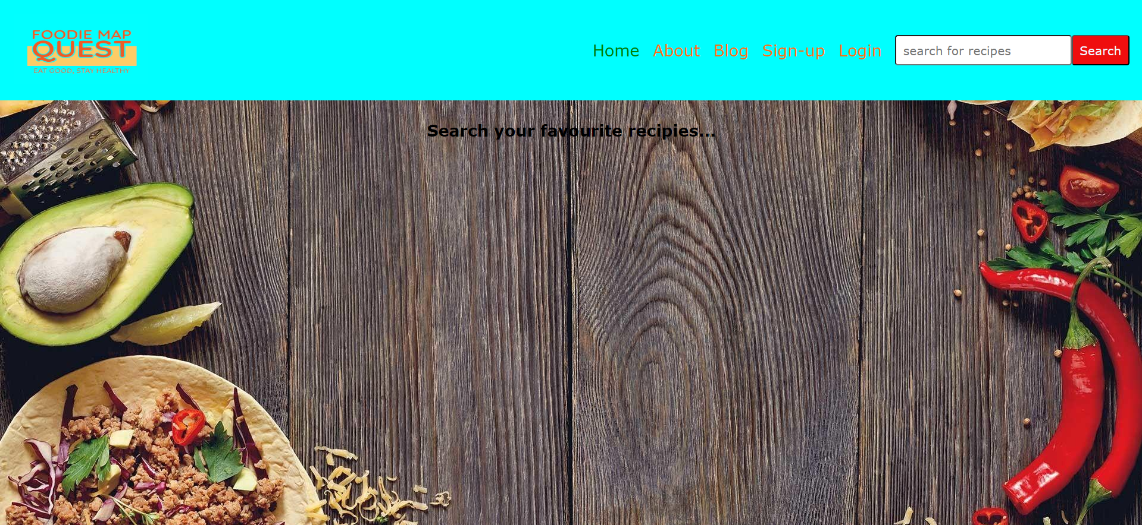
CSS

Slide 15
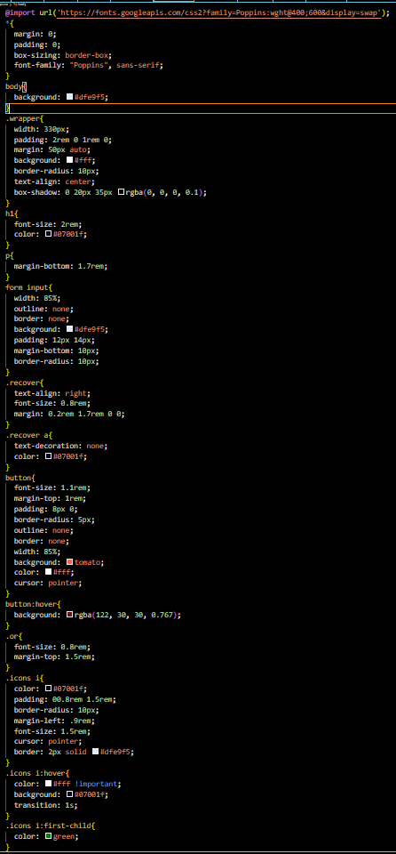
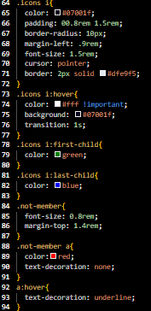
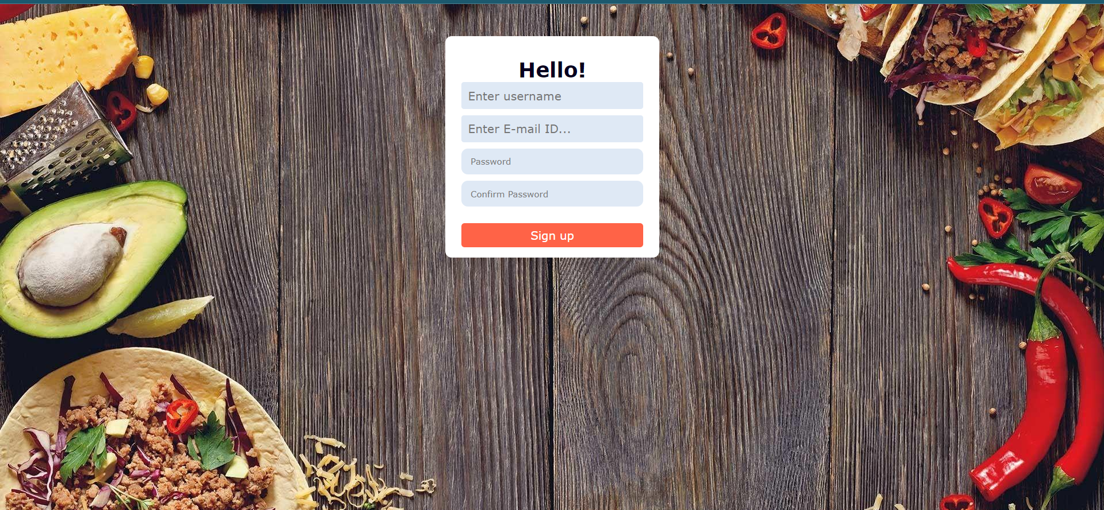
CSS

Slide 16
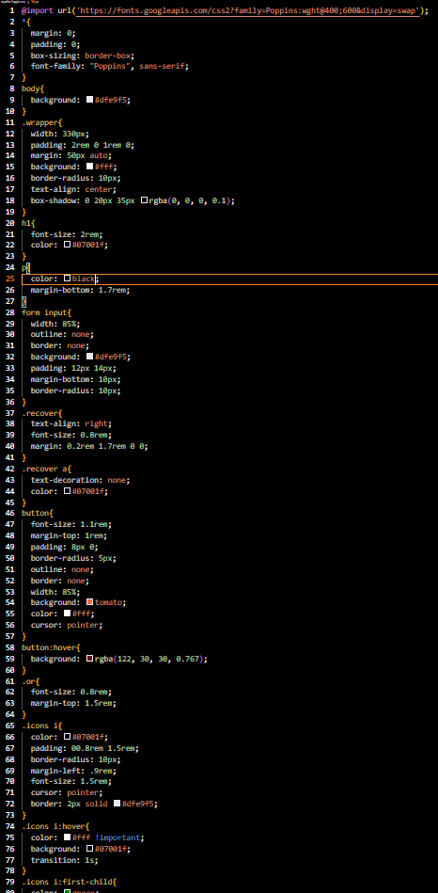
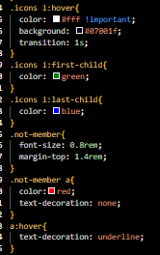
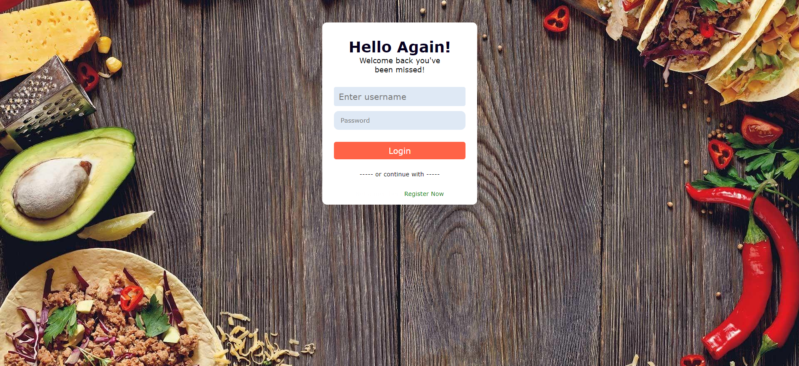
CSS

Slide 17
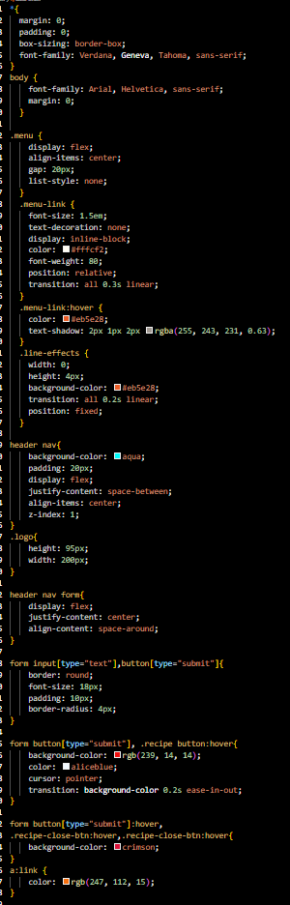
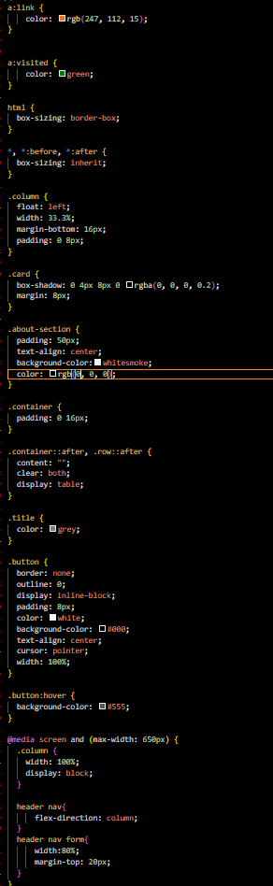
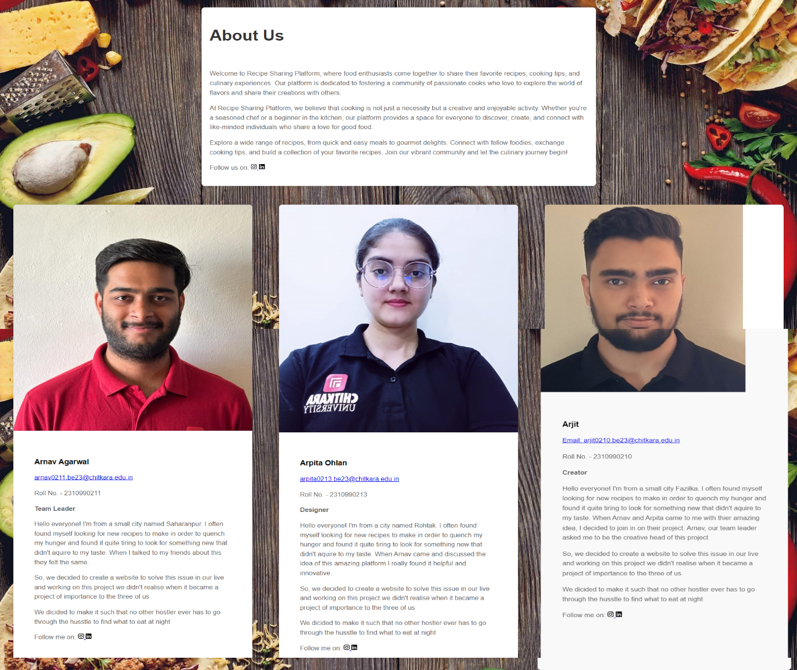
CSS

Slide 18
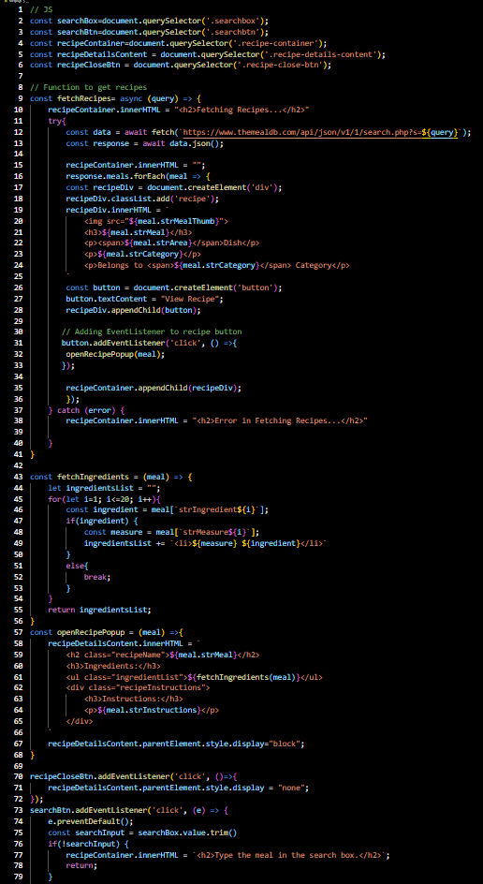
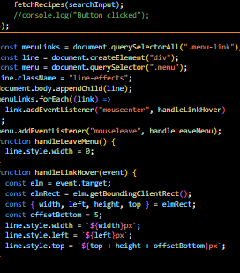
Js

Slide 19
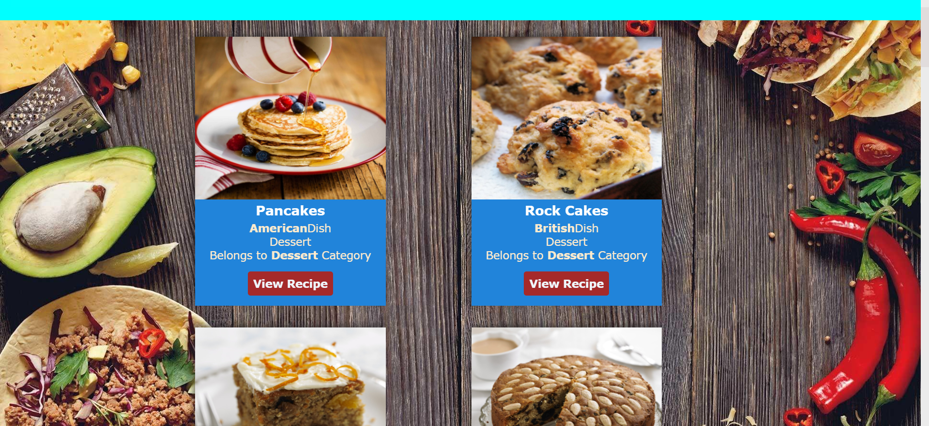
Js

Slide 20

Conclusion
The requirements are collected by keeping the user requirements in mind.
Functionality wise in this application, users can search for their favorite recipes.
They can filter and sort the display order of search results. By liking the recipes they can create their own favorite collection.
The web application is efficient as it tested against various scenarios.

Slide 21

Reference Link 1.https://cdnjs.cloudflare.com/ajax/libs/font-awesome/5.15.1/css/all.min.css 2.https://www.themealdb.com/api/json/v1/1/search.php?

Slide 22
Thank You

